Slide 1
k-Nearest Neighbors

Slide 2
What’s the Difference?
k-means
k-nearest neighbors
Unsupervised
For clustering
No x/y variables
Based on the center points of the data
Supervised
For classification
Need to specify an x and y
Based on distance between data

Slide 3
General Steps in KNN
Data Wrangling
Fit the model
Choose the best model
Find the accuracy of that model

Slide 4
Data Wrangling Requirements
Scale the data
Train/Test/Split

Slide 5
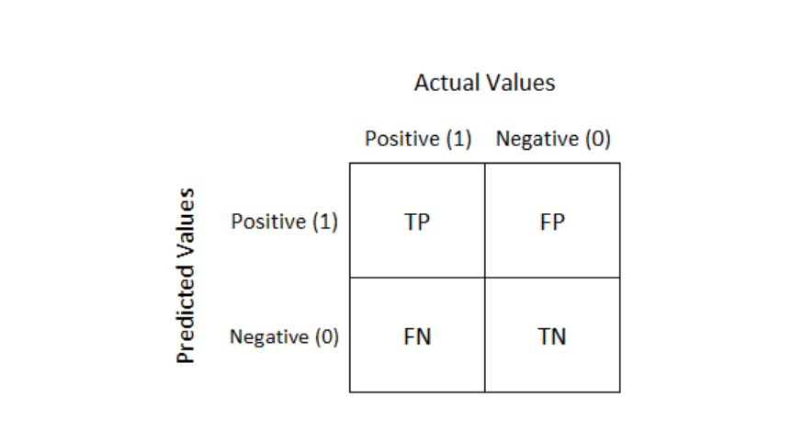

Interpreting the Confusion Matrix
TP: True Positive
TN: True Negative
FP: False Positive
FN: False Negative

Slide 6
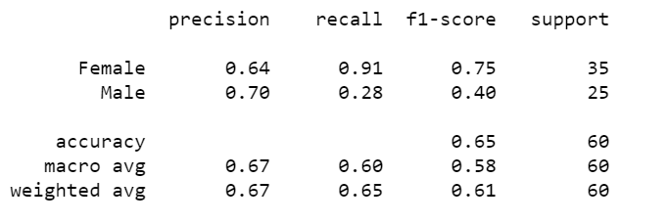
Eeek, what matters here?
Look at the accuracy on the bottom

